Slide 1
Data curation tooling – AgroHack 2016
Simon Jupp
Samples, Phenotypes and Ontologies Team
European Bioinformatics Institute

Slide 2

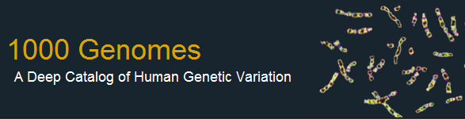

















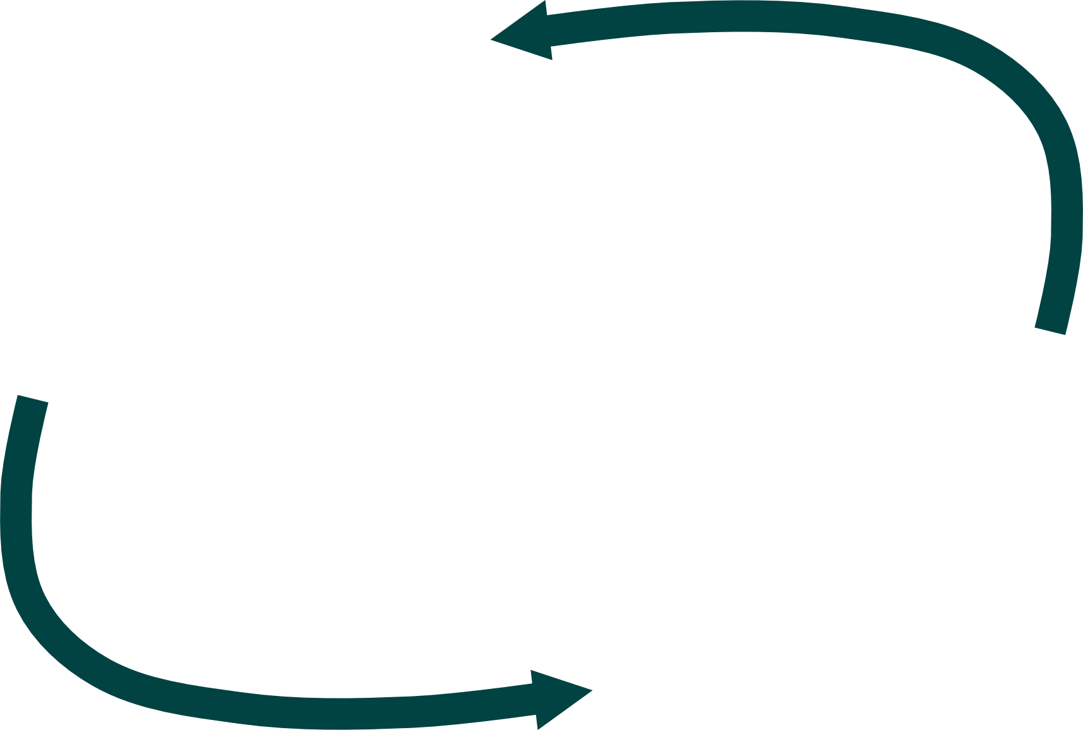


Raw Data to Explicit Knowledge
Ontology building
Data Exploration
and
Cleanup
Webulous
Ontology Annotation
Data structuring
Data cleaning and mapping
Notes:
This slide serves to highlight our fundamental process. We provide tools to help people cleanup their data, make it easier to integrate with other resources, annotate with ontologies to provide search expansion, structure it better to facilitate integration. Mention briefly each of these tools – OLS is ontology repository serving reasoned views over 150 ontologies, Zooma helps predict mappings to ontology terms from text, Webulous helps curators etc request new terms, EFO is designed to support application building using the ontology

Slide 3
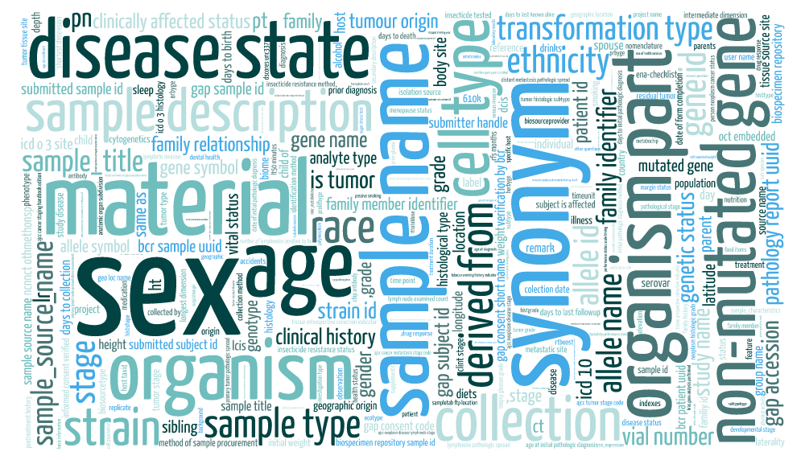
Thousands of sample attributes…

Slide 4
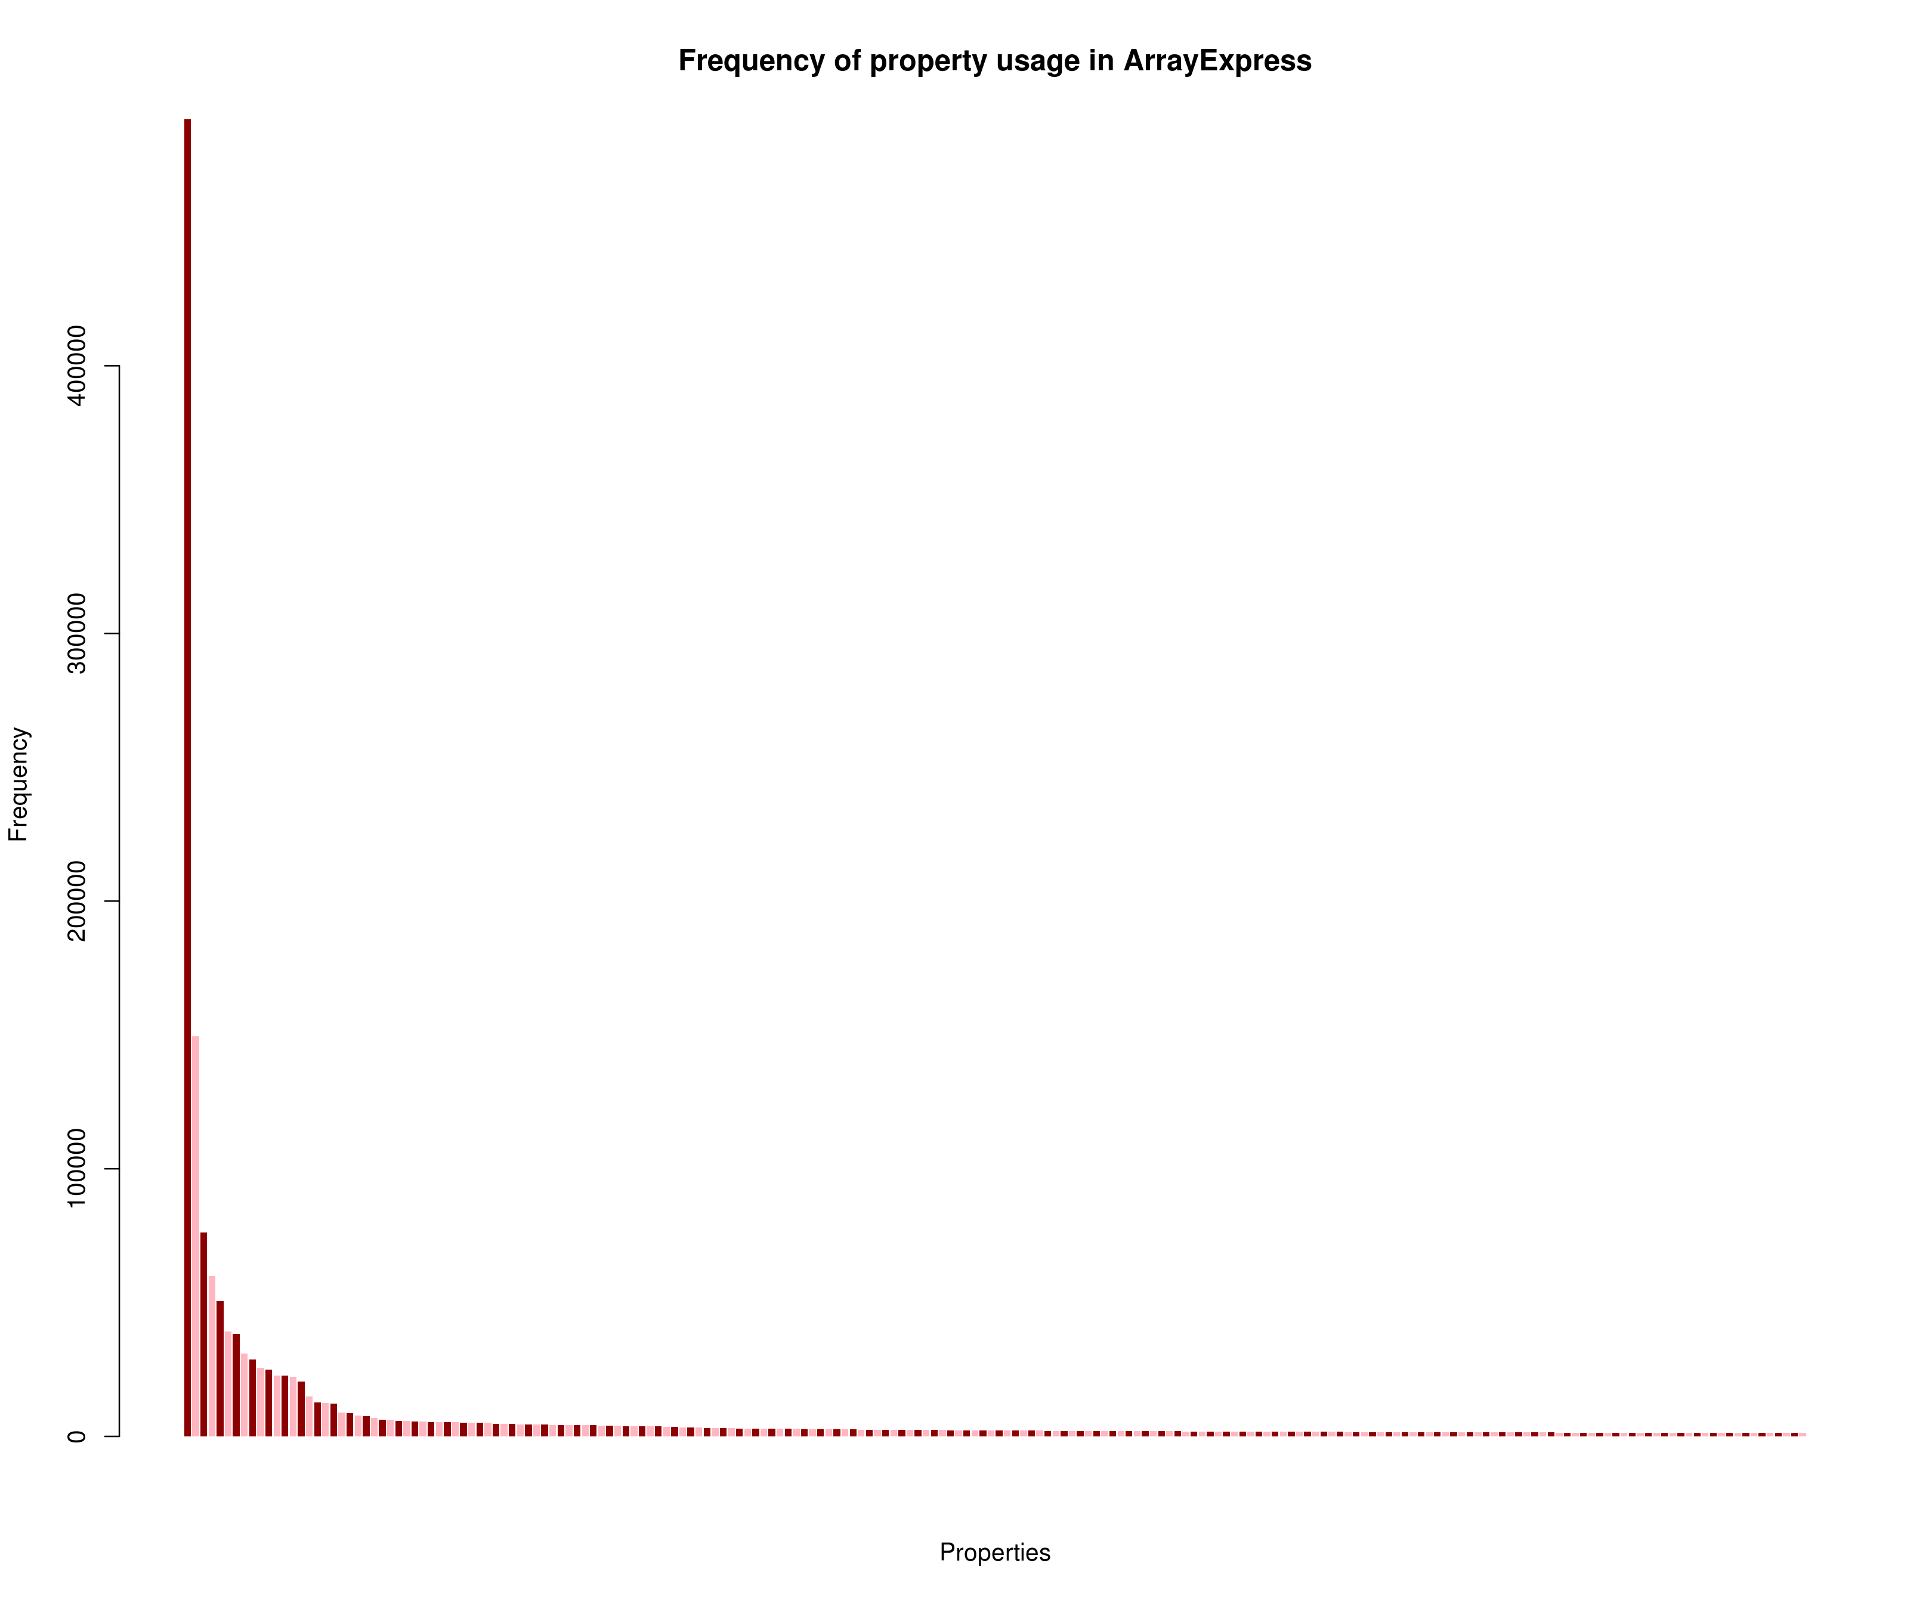
Curation - Dirty data and the long tail
There is much variation in the data we receive
This is top 200. There are nearly 250,000 in total and half are used only once
gender:female
sex:female
disease:breast cancer
frequency=2285
frequency=1288
100
200

Slide 5
Data comes in many forms
We need fuzziness which is hard to do programmatically
Input from submission | Ontology class
2’-deoxy-5-azacytidine | 5-aza-2’-deoxycytidine
Ovarian Cancer | ovarian carcinoma
Anterior tibialis | tibialis anterios
Barret&#39;s Esophagus | Barrett’s esophagus
Endothelium, Vascula | cardiovascular system endothelium

Slide 6
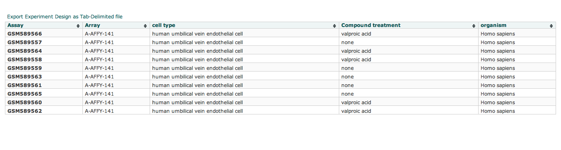


Sample description with semantic markup
CL:CL_0000071
(blood vessel endothelial cell)
NCBITaxon:NCBITaxon_9606
(Homo Sapiens)
Curation
obo:CHEBI_39867
(valproic acid)

Slide 7
Automated ontology mapping with Zooma
http://www.ebi.ac.uk/fgpt/zooma

Slide 8


Integrated search and ranking
Query for “abnormal nuclear morphology”
Merged results
Hit | Ontology term match | Evidence | Confidence | Souce
abnormal nuclear morphology | CMPO_12345 | 3 database, 356 annotations | HIgh | Zooma
abnormal nuclear morphology | FYPO_85687 | 0 database | Low | OLS

Slide 9
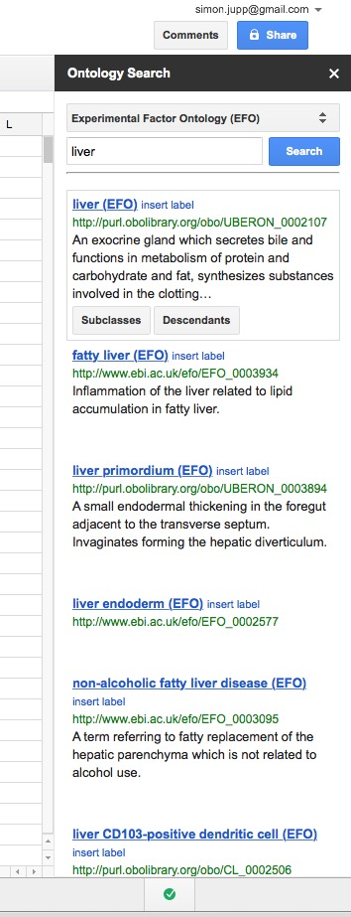
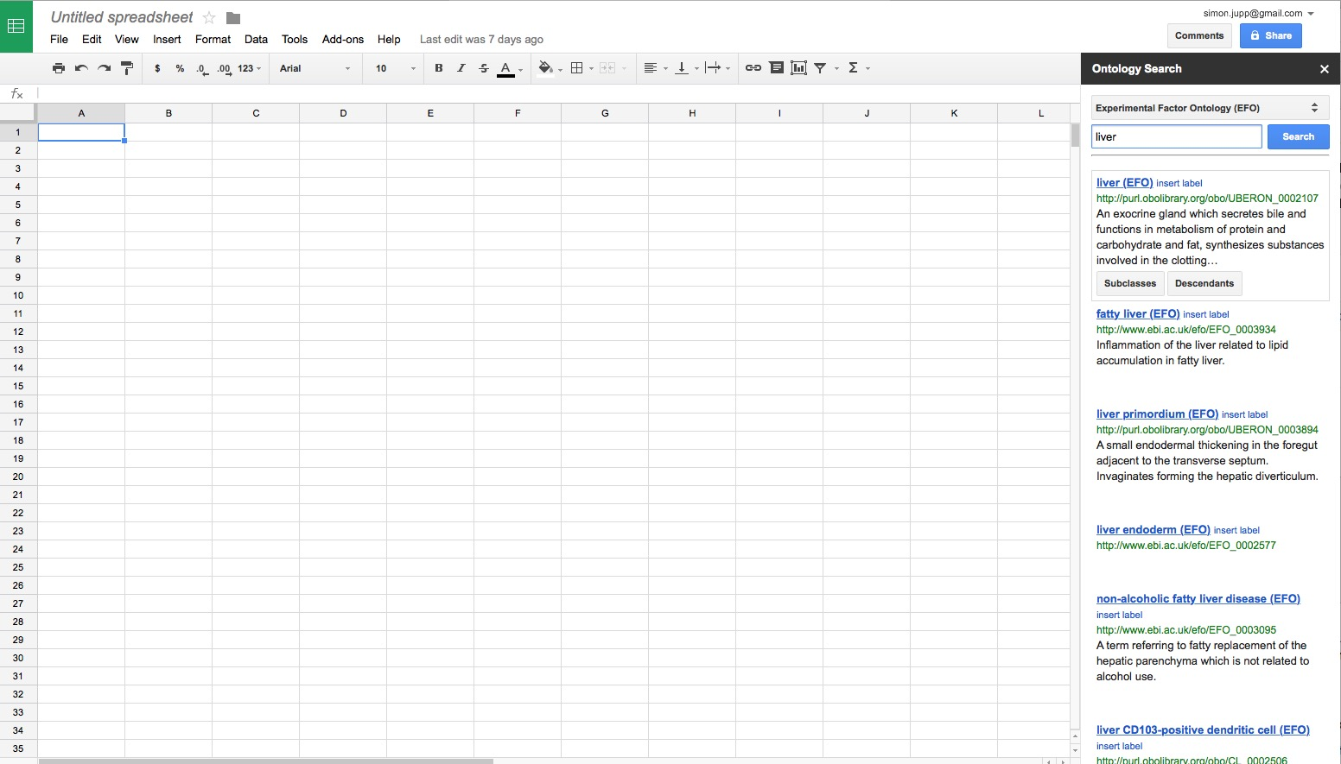

Sidebar for search BioPortal and creating data validations from ontology terms

Slide 10
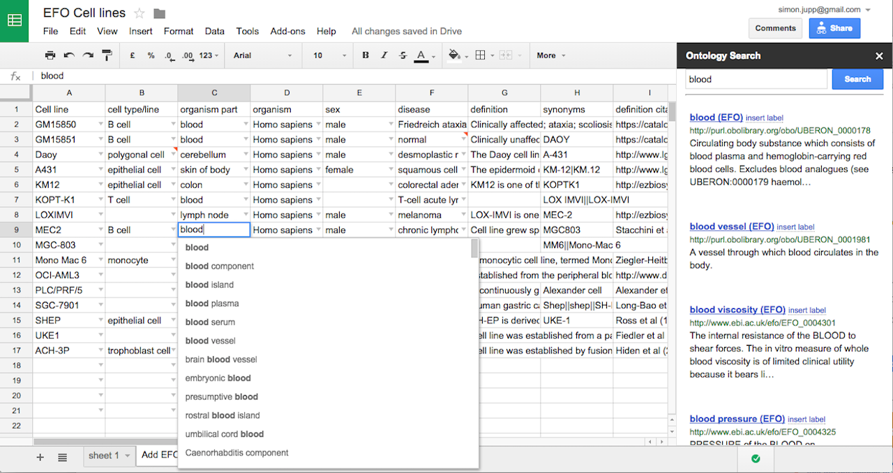
Users input
Users fill in templates and submit back to server from within Google Sheet

Slide 11
Hack proposal
Set up AgroZooma instance
We already have some curated plant data to load
Add any data you have
Develop Google Add-On for auto annotating spreadsheet data
Query Zooma + NCBO services
Any “fixes” get pushed back into Zooma
How to contribute to this hack
We need curated datasets (samples/phenotypes)

Slide 12
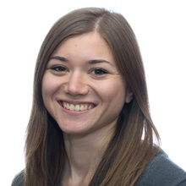

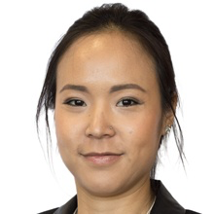




Ontology team
Olga Vrousgou
Sira Sarntivijai
Thomas Liener
Funding
EMBL
CORBEL This project receives funding from the European Union’s Horizon 2020 research and innovation programme under grant agreement No 654248.
EXCELERATE ELIXIR-EXCELERATE is funded by the European Commission within the Research Infrastructures programme of Horizon 2020, grant agreement number 676559.
Tony Burdett
Helen Parkinson

